Slide 1
From the Nobel Prize Citation for Nadine Gordimer, December 1991
“Her continual involvement on behalf of literature and free speech in a police state where censorship and persecution of books and people exist have made her ‘the doyenne of South African letters.’
Gordimer writes with intense immediacy about the extremely complicated personal and social relationships in her environment. At the same time as she feels a political involvement – and takes action on that basis – she does not permit this to encroach on her writings.”

Slide 2
“At is on the side of the oppressed. Think before you shudder at the
simplistic dictum and its heretical definition of the freedom of art.
For if art is the freedom of the spirit, how can it exist within the
oppressors?”
Nadine Gordimer, 1984
“The gap between the committed and the indifferent is a Sahara whose faint trails, followed by the mind’s eye only, fade out in the sand.”
Nadine Gordimer, 1963

Slide 3
“The primacy of the word, the basis of the human
psyche, that has in our age been used for mind-bending
persuasion and brain-washing pulp, disgraced by
Goebbels and debased by advertising copy, remains
a force for freedom that flies out between all bars.”
Nadine Gordimer

Slide 4
“In a democracy – even a so-called democracy like our white-elitist one – the greatest veneration one can show the rule of law is to keep a watch on it, and to reserve the right to judge unjust laws and the subversion of the function of law by the power of the state. That vigilance is the most important proof of our respect for the law.”
Nadine Gordimer

Slide 5
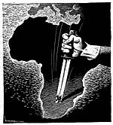

Slide 6
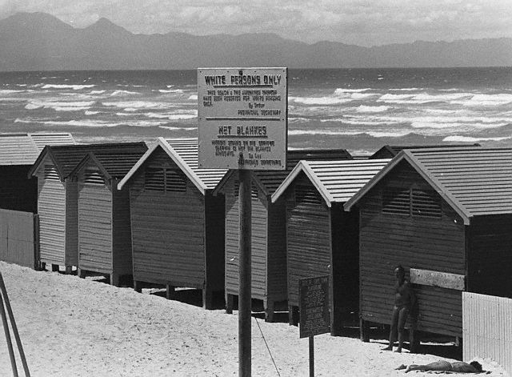

Slide 7
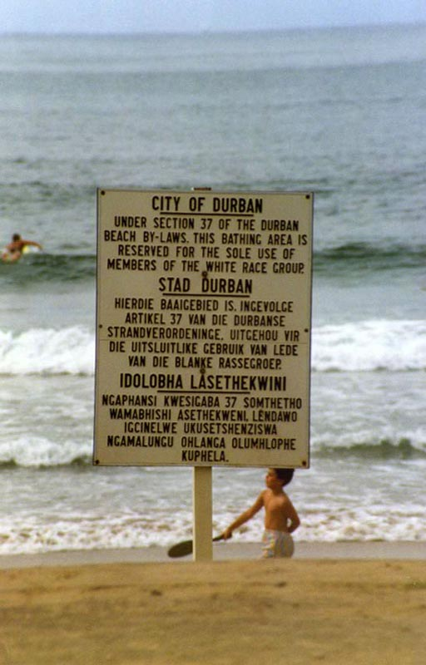

Slide 8
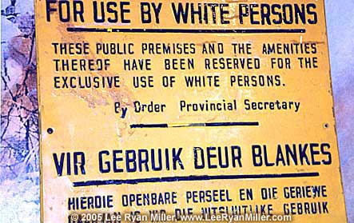

Slide 9
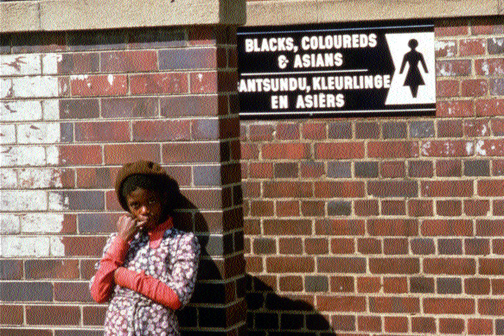

Slide 10
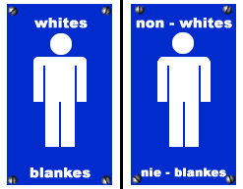

Slide 11
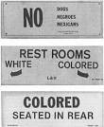


Notes:
Left 3: Florida; top right: Arizona; bottom right: Georgia

Slide 12
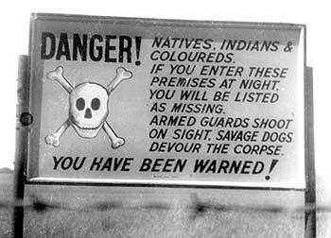

Slide 13
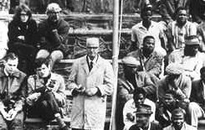

Slide 14
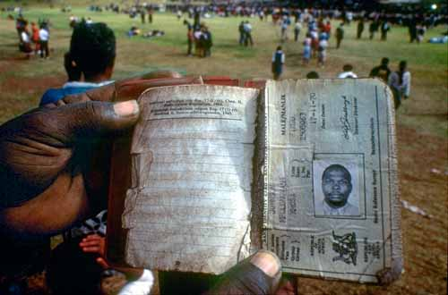

Slide 16
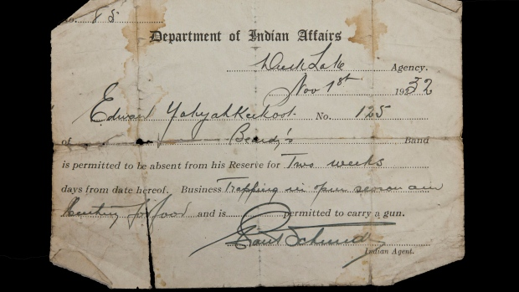

Slide 17
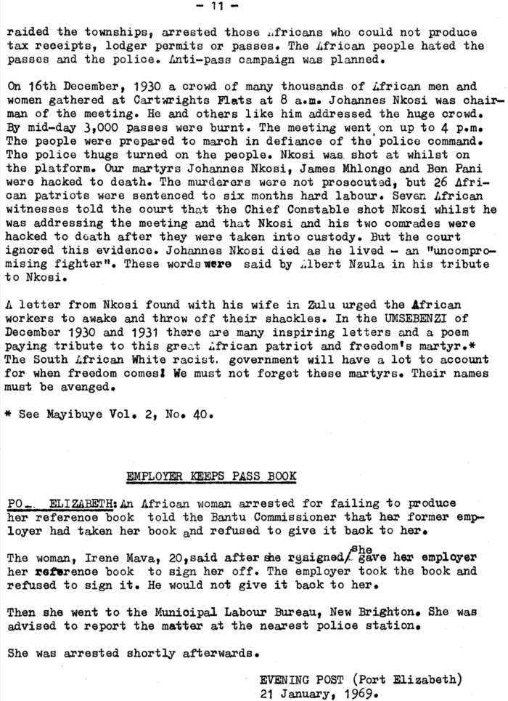

Slide 18
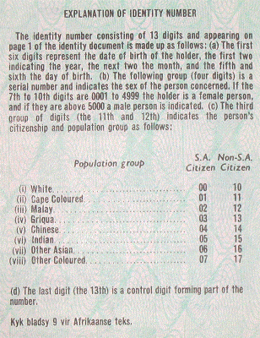

Slide 19
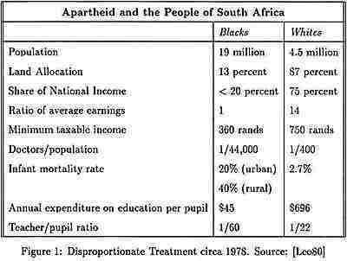

Slide 20
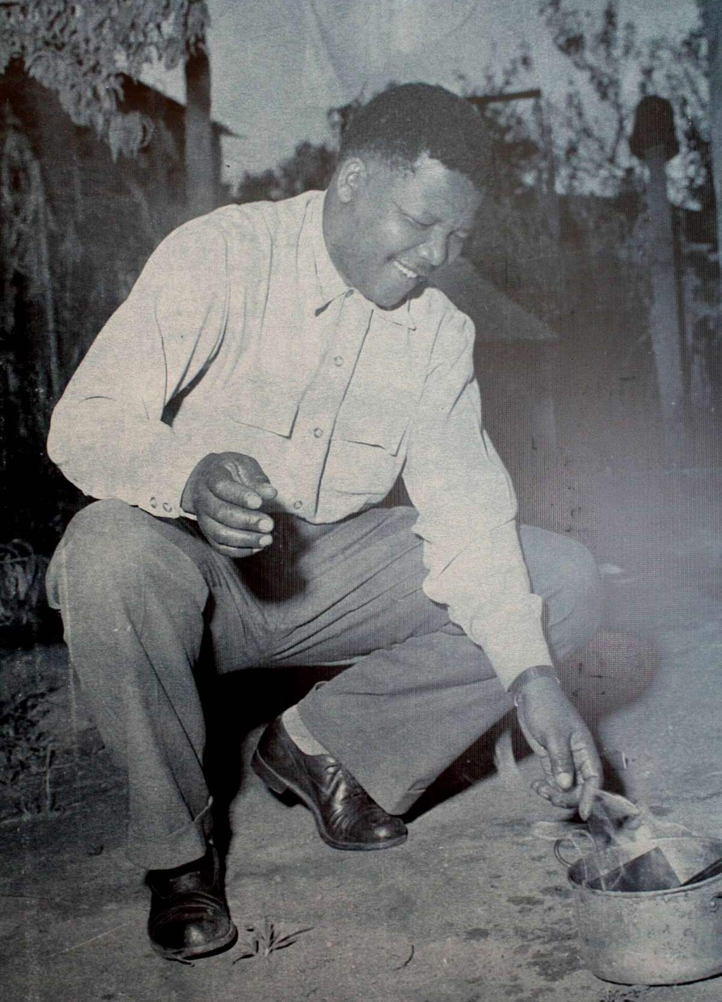
1960

Slide 21
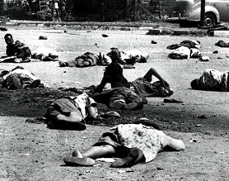
Sharpeville Massacre, March 21, 1960

Slide 22
From WHEN LIGHTS GO OUT
(for some who are in south african jails)
Mongane Wally Serote
can we tell you
you the children of a long hour a long day a long night
that hope never befriends fools
yes
time, in absolute eloquence, can erase our faces
remember sharpeville?
in those days, violence and disaster were articulate
and now
today you watch and wait

Slide 23
The Natives Land Act of 1913^{[1]} was the first major piece of segregation legislation passed by the Union Parliament. It was replaced by the current policy of land restitution. The act decreed that only certain areas of the country could be owned by natives. These areas initially totaled less than 10% of the entire land mass of the Union, later expanded to 13%.
The Population Registration Act, 1950, required that every South African be classified into one of a number of racial "population groups". This act provided the foundation upon which the whole edifice of apartheid would be constructed.
The Reservation of Separate Amenities Act, 1953 allowed public premises, vehicles and services to be segregated by race, even if equal facilities were not made available to all races.
The Mines and Work Act legally established South Africa's employment "colour bar,“ originally passed in 1911 and amended in 1912 and 1926 before undergoing further changes in 1956 and 1959. This was enacted to establish the duties and responsibilities of workers in Mines and Works in South Africa.
The Native Building Workers Act, 1951 (Act No. 27 of 1951; subsequently renamed the Bantu Building Workers Act, 1951 and the Black Building Workers Act, 1951). Sections 15 and 19 made it an offense for blacks to work in the employ of whites performing skilled labor in their homes.

Slide 24
The Asiatic Land Tenure and Indian Representation Act, 1946 restricted land ownership
by Asians in towns and cities.
The Prohibition of Mixed Marriages Act, Act No 55 of 1949, was an apartheid law in South Africa that prohibited marriages between people of different races.
The Immorality Act, 1927 (Act No. 5 of 1927) prohibited extramarital sex between white people and people of other races. In its original form it only prohibited sex between a white person and a black person, but in 1950 it was amended to apply to sex between a white person and any non-white person.
Pass Laws The Natives (Urban Areas) Act of 1923 deemed urban areas in South Africa as "white" and required all black African men in cities and towns to carry around permits called "passes" at all times. Anyone found without a pass would be arrested immediately and sent to a rural area. It was replaced in 1945 by the Natives (Urban Areas) Consolidation Act, 1945 which imposed essentially the same restrictions. This Act outlined requirements for African peoples' "qualification" to reside legally in white metropolitan areas.
The Group Areas Act, 1950 (re-enacted in 1957 and 1966) divided urban areas into "group areas" in which ownership and residence was restricted to certain population groups.
The Bantu Education Act, 1953 (Act No. 47 of 1953; later renamed the Black Education Act, 1953) enforced racially separated educational facilities.

Slide 25
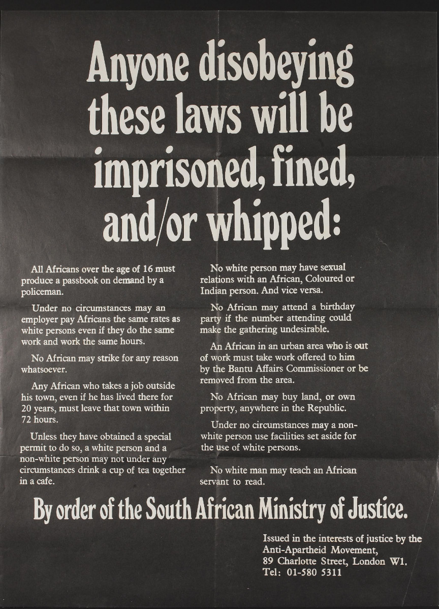

Slide 27


Slide 28


Slide 29
We are not the driftwood of distant oceans
our kinsmen are a thousand centuries old
only a few nations begat civilization
not of gold, not of things but of people.
Professor Mazisi Kunene
(Unesco declared “Africa’s Poet Laureate,” 1993)

Slide 30

The Weeping of the Penny Whistle*
The penny whistle begins to weep
in my dreams: when was it I heard it
for the first time, and now I cannot silence it.
It weeps, monotonously, like the water
running over the stones in Jonkershoek Valley.
It weeps like the wind: it weeps in the distance.
It weeps for all whistlers who have died
in the long years of hunger and birdshot.
It weeps in the sand that has been drenched
with the blood of passers-by
when the bombs exploded
in bars and churches.
It weeps in the trees, it weeps with the birds,
it weeps in my dreams climbing the scales
of sorrow and madness.
Peter Horn
*Penny whistle – one of the key instruments in kwela, a form of South African street music; the word kwela has 2 meanings, “get up” and when doubled (“kwela-kwela”) a slang reference to the police vans used by the Apartheid regime. The penny whistle became a symbol of opposition to Apartheid.

Slide 31
Poems At Bargain Prices
Poems? You want poems? We got poems.
Poems to make you dream
While the rulers of the country are busy
Poems to send you asleep
While they test their tanks and their guns.
We got poems.
Poems for you and your afternoon sleep.
Poems which do not disturb you nor
The quiet of a Sunday afternoon,
When the sermon in the morning was comforting
And the chicken broth was tasty.
We got poems.
Ah, you sleep?
  May you wake in peace!
  Because we got other poems.
  Poems which will disturb you
  With announcements of bloodshed,
  War, atrocities, atomic bombs, and jails.
  Jails, visible from the window
  Of your peaceful bedroom
  Whenever you open the blinds.
  Poems.
  You do not want to hear these poems?
  They will come to you nonetheless.
  Peter Horn

Slide 32
HEAT AND SWEAT
(for sisters and brothers who may be weary)
so you keep looking back
if you did not listen when the past was breathing
the present erases your name
child don’t let laughter from insane strangers snatch our faces
the present is surprised at our songs
it is shocked that we still walk the streets the way we do
lost as we are
torn and bewildered by the sounds of our names
it is surprised that though the sight of our eyes staggers
and though the gait of our shadows seems to limp
we still put brick on brick and tell our children stories
so you keep looking back
even when the darkness is so thick it could touch your eyeballs
even when the darkness is such a huge space
ready with an insatiable thirst, swallowing, and even ready still to swallow
the last red drop that trickles still from your little heart,
don’t you hear the songs
they can live in the present if we let them
these songs have a prowess of our mother’s back
and the eloquence of our grandmother's foresight
about the time that never was
and the earth whose rhythm is an intoxicated dizziness
child
feel the wall while you walk and hold, hold
glue your eye into the distance and keep walking
move, child, move
if we don’t get there
nobody must . . .
Mongane Wally Serote

Slide 33
For Sale
by Susan Rich
Xhosa women in clothes too light
for the weather have brought wild flowers
and sit sloped along the Claremont road.
I see her through rolled windows,
watch her watch me to decide if I’ll pay.
It’s South Africa, after all, after apartheid;
but we’re still idling here, my car to her curb,
my automatic locks to her inadequate wage.

Slide 34
July’s People
Mwawate

Slide 35
At first what fell into place was what was vanished, the past. . . . Her school shoes, cleaned by Our Jim. . .were outside the door.
3

Slide 36
But Victor nagged for his racing car track . . .
13-14

Slide 37
She say, she can be very pleased you are in her house. She can be very glad to see you, long time now, July’s people. . . . 15-17
Her son, who had seen the white woman . . .
21
The white woman’s hand . . .
Without his white people back there. . .
22
NOTE: Language – see p. 44-5

Slide 38
. . . Maureen’s little legacy of De Beers shares her maternal grandmother had left her.
8

Slide 39
The decently paid and contented male servant, living in their yard since they had married . . .
9

Slide 40
Bam and Infrastructure
24-5

Slide 41
I Promessi Sposi
28
They had nothing . . .
29

Slide 42
BOSS BOY
30

Slide 43
“A black miner’s badge of rank, the highest open to him.”
29

Slide 44
But I’m work for you. Me I’m your boy.
69

Slide 45
“Herrenvolk”
30-3

Slide 46
Why had Lydia carried the case?
Did the photographer know what he saw, when they crossed
the road like that, together? Did the book, placing the pair in
Its context, give the reason she and Lydia, in their affection
and ignorance, didn’t know?
33

Slide 47
-- You say I can come inside? – He used to have the habit of knocking at a door, asking, The master he say I can come in? . . .
-- And where were you yesterday? What’s the story?
(How many times . . .) 111
And he patted the car keys in his pocket.
52-3

Slide 48
I would never have thought he would do something like that. He’s always been so correct. . . .
58
Even my pass, no one can ask any more. It’s finished
59
He thought of the pass-book as finished. . . .
137

Slide 49
He leaned forward confidentially . . .
59
A wave of red feeling – it seemed to flash from Bam’s fine pate to her –
Again, she gained foothold, spoke from there. . . It’s—you know. . . It’s not for white people.
60

Slide 50
There was in his dark profile . . .
62-3

Slide 51
You don’t like I must keep the keys. Isn’t it. I can see all the time. You don’t like that . . .
69
No. No. No. You don’t like it I must have these keys.
70-1

Slide 52
How many you got there by Mwawate’s place?
120

Slide 53
Learning ballet dancing instead of the despised Fanagalo 127
See: Gullah

Slide 54
She was not in possession of any part of her life . . .
139
When the white family got back to the hut the gun was gone.
142

Slide 55
You c’n tell the police, dad.-- . . .
She looked down on this man who had nothing, now.
145
She was unrecorded in any taxonomy but that of Maureen Hetherington on her points to applause in the Mine Recreation Hall.
148

Slide 56
--You– He spread his knees and put an open hand on each.
152

Slide 57
. . . Saviours or murderers;
158
She walks out of the hut. . . .
159
She runs: . . .
160

